Slide 1
Real Estate Investment Advisor: Predicting Property Profitability & Future Value Mini project -2
Presented By
Anushka T
Weekday batch (AIML)

Slide 2
Introduction
Real estate is one of the most important investment sectors.
People often face difficulty in deciding:
Whether a property is worth buying
Whether the price is reasonable
How much the property value may increase in future
Traditional property analysis requires:
market knowledge
manual comparison
expert consultation
This project uses Machine Learning techniques to:
analyze property data
predict investment quality
estimate future property prices
The system provides fast and data-driven property analysis through an interactive Streamlit application.

Slide 3
Problem Statement
Many property buyers and investors struggle to:
identify profitable properties
compare different locations
estimate future property growth
make quick investment decisions
Existing methods are:
time consuming
dependent on real estate agents
less data-driven
Therefore, there is a need for an intelligent system that can:
analyze property features
predict investment quality
estimate future property prices automatically

Slide 4
Project Objectives
To develop a machine learning based Real Estate Investment Advisor
To predict whether a property is a good investment
To estimate property price after 5 years
To perform Exploratory Data Analysis (EDA)
To compare multiple ML algorithms
To build a user-friendly Streamlit web application
To provide quick and accurate property analysis

Slide 5
Technologies Used
Programming Language
Python
Libraries Used
Pandas
NumPy
Matplotlib
Seaborn
Scikit-learn
XGBoost
Pickle
Web Framework
Streamlit
Development Environment
VS Code

Slide 6
Dataset Overview
Dataset Name
India Housing Prices Dataset
Total Records
250,000 property records
Important Features
State
City
Locality
Property Type
BHK
Size in SqFt
Price in Lakhs
The dataset contains both:
numerical features
categorical features
which are useful for machine learning analysis.
Furnished Status
Parking Space
Amenities
Security
Public Transport Accessibility
Owner Type
Availability Status

Slide 7
Data Preprocessing
Data preprocessing is an important step before training machine learning models.
The following preprocessing steps were performed:
Handling Missing Values
Missing values were handled using forward fill method.
Removing Duplicates
Duplicate records were removed to improve data quality.
Feature Engineering
New features were created:
Future_Price_5Y
Appreciation_Percentage
Good_Investment or not a good invesment
Encoding Categorical Data
Label Encoding was used to convert text columns into numeric values.
Final Processed Dataset
The cleaned dataset was saved for model training.

Slide 8
Exploratory Data Analysis (EDA)
EDA was performed to understand:
data distribution
feature relationships
trends and patterns
The following analyses were performed:
Property Price Distribution
Property Size Distribution
Property Type Analysis
Outlier Detection
Correlation Heatmap
Visualization libraries:
Matplotlib
Seaborn
were used to generate graphs and plots.

Slide 9
EDA Visualizations
Histograms
price distribution
property size distribution
Scatter Plots
size vs price
transport accessibility vs price
Box Plots
BHK vs price
amenities vs price
furnished status vs price
Heatmap
Used to identify correlations between numerical features.
These visualizations helped in understanding important property trends.

Slide 10
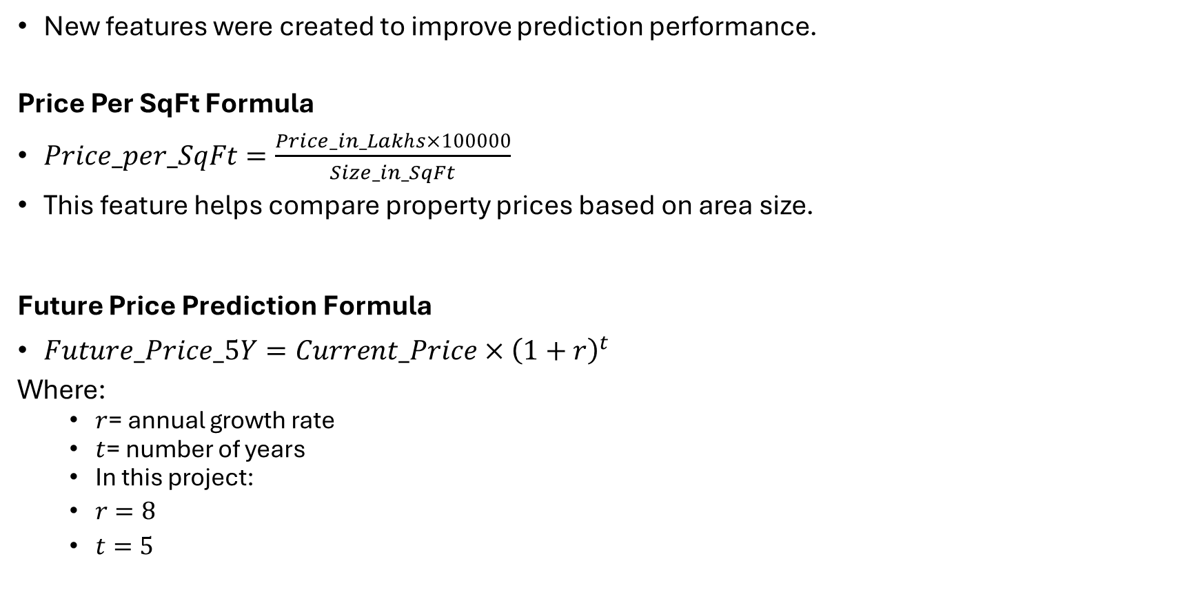
Feature Engineering
New features were created to improve prediction performance.
Price Per SqFt Formula
$Price_per_SqFt=\frac{Price_in_Lakhs×100000}{Size_in_SqFt}$
This feature helps compare property prices based on area size.
Future Price Prediction Formula
$Future_Price_5Y=Current_Price×{\left(1+r\right)}^{t}$
Where:
$r$= annual growth rate
$t$= number of years
In this project:
$r=8$
$t=5$

Slide 11
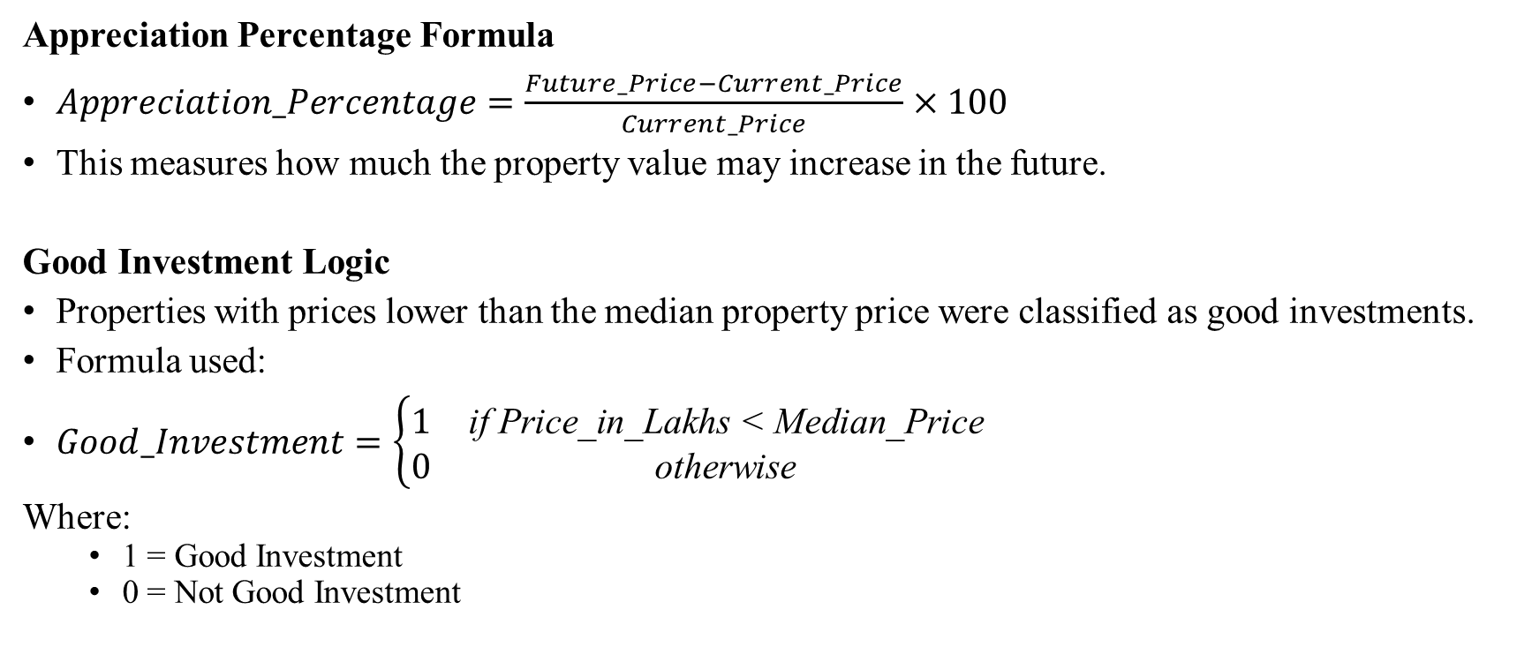
Appreciation Percentage Formula
$Appreciation_Percentage=\frac{Future_Price−Current_Price}{Current_Price}×100$
This measures how much the property value may increase in the future.
Good Investment Logic
Properties with prices lower than the median property price were classified as good investments.
Formula used:
$Good_Investment=\left\{\begin{matrix}1 & \text{if} \text{Price}\text{_}\text{in}\text{_}\text{Lakhs}\text{ < }\text{Median}\text{_}\text{Price} \\ 0 & \text{otherwise}\end{matrix}\right.$
Where:
1 = Good Investment
0 = Not Good Investment

Slide 12
Model Building
Different Machine Learning algorithms were used to predict whether a property is a good investment and to estimate the future property price after 5 years.
Before training the models, the dataset was divided into:
Training dataset
Testing dataset
Data Splitting
The dataset was split using the train-test split method.
80% of the data was used for training the models.
20% of the data was used for testing and evaluating model performance.
This splitting helps the model learn patterns from training data and test its prediction accuracy on unseen data.

Slide 13
Classification Models Used
The following classification algorithms were used to predict whether a property is a good investment:
Logistic Regression
Decision Tree Classifier
Random Forest Classifier
Support Vector Machine (SVM)
XGBoost Classifier
These algorithms were chosen because they use different learning methods and help compare model performance effectively.

Slide 14
Regression Models Used
The following regression algorithms were used to predict future property prices:
Linear Regression
Decision Tree Regressor
Random Forest Regressor
Support Vector Regressor (SVR)
XGBoost Regressor
These models were selected because they are effective for predicting continuous numerical values such as future prices.

Slide 15
Final Model Selection
Final Classification Model
XGBoost Classifier
Accuracy: 98.35%
Precision: 98.22%
Recall: 98.44%
ROC AUC Score: 98.35%
Reason for Selection
Achieved the highest classification accuracy.
Provided better overall prediction performance.

Slide 16
Final Regression Model
Random Forest Regressor
RMSE: 13.47
MAE: 10.52
R² Score: 99.57%
Reason for Selection
Achieved the highest R² score.
Produced the lowest prediction error.
Predicted future property prices more accurately than other models.

Slide 17
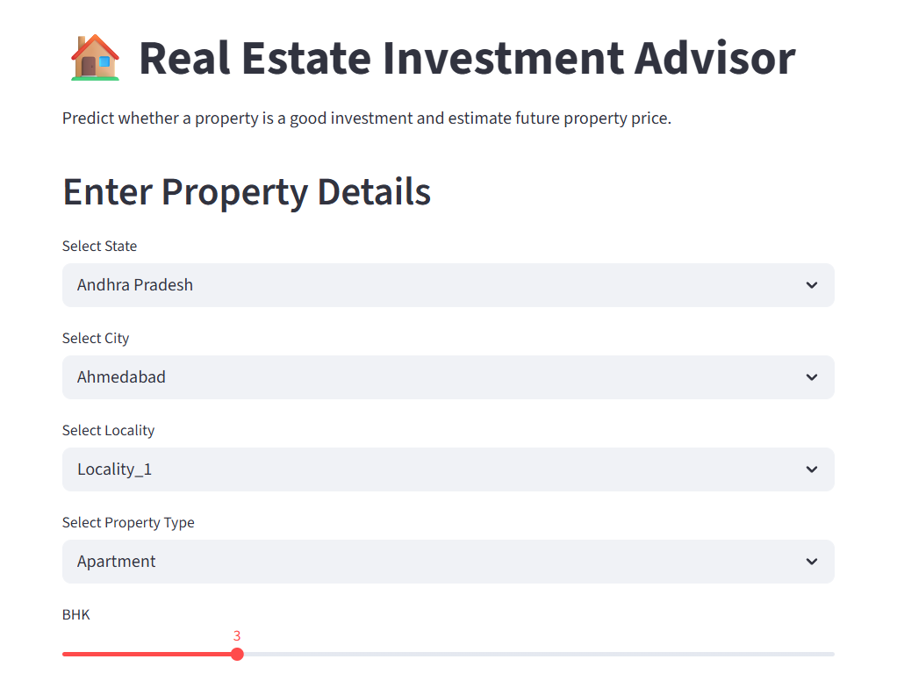
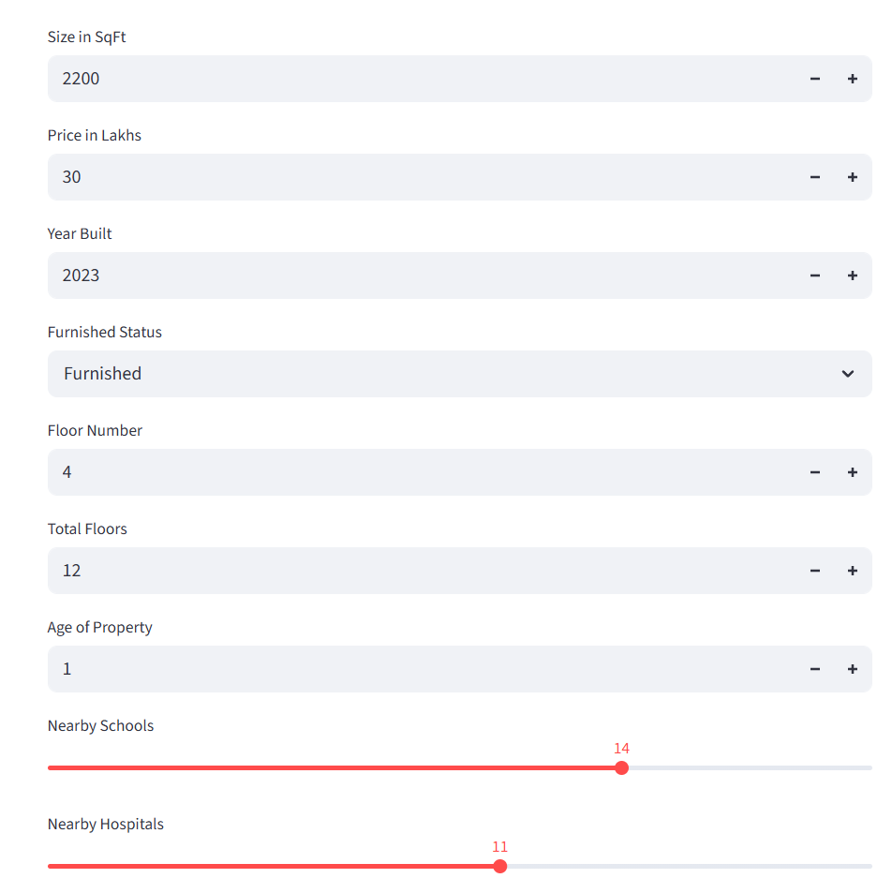
OUTPUT SCREENSHOT

Slide 18
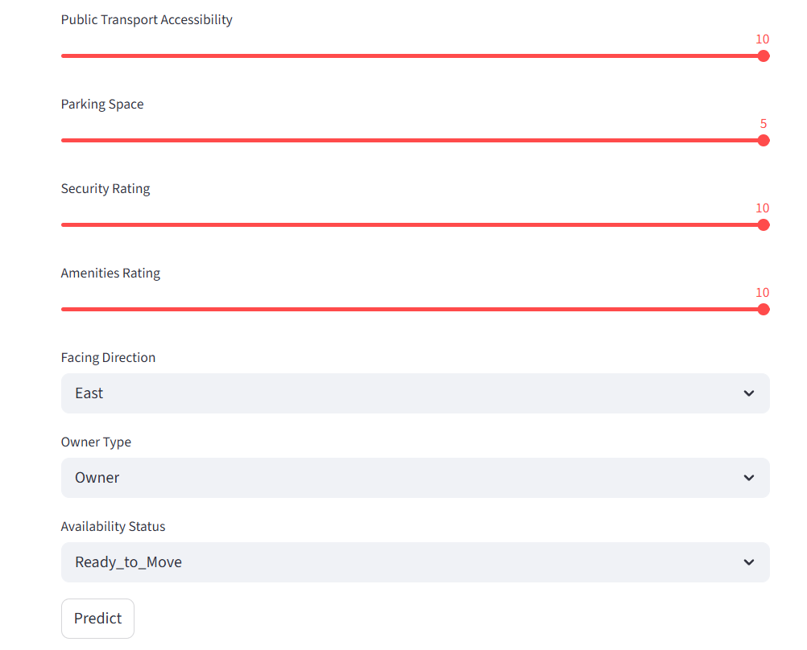
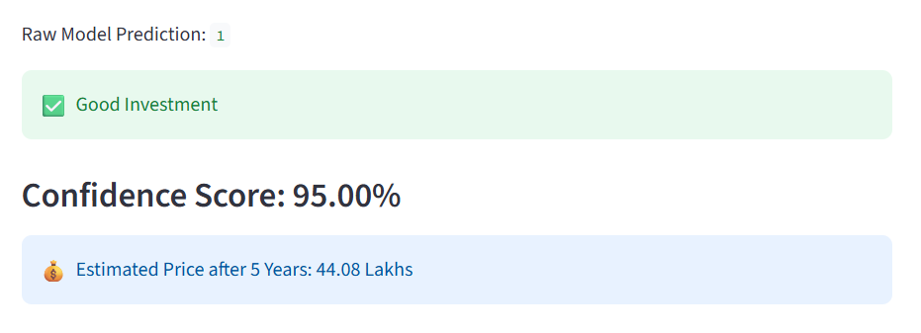

Slide 19
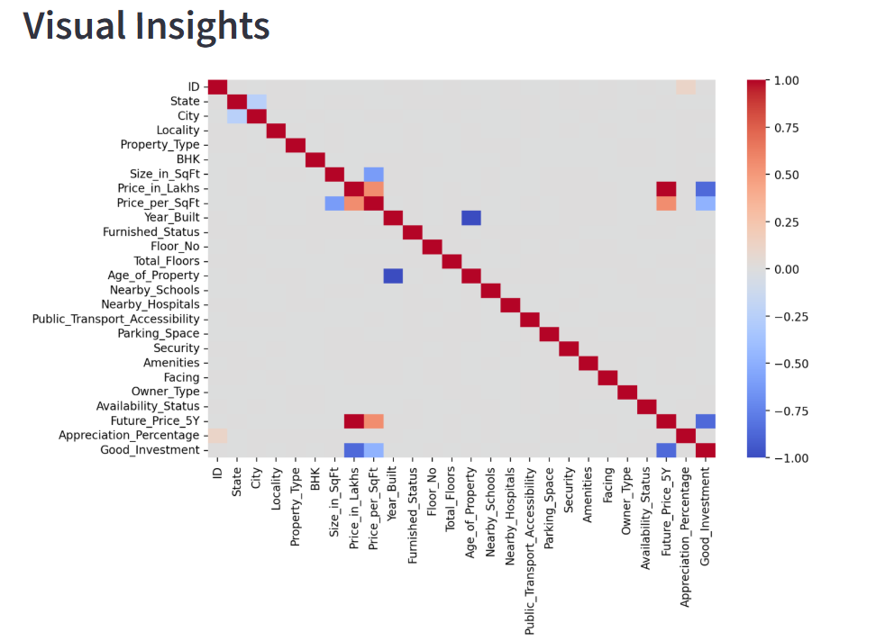
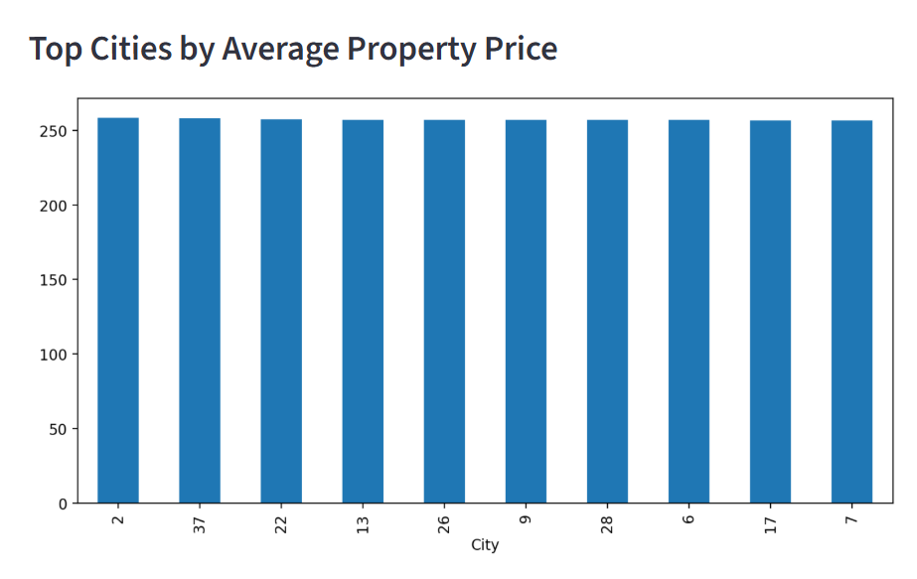

Slide 20
Conclusion
This project successfully developed a Machine Learning based Real Estate Investment Advisor system that predicts whether a property is a good investment and estimates future property prices. Features such as property size, location, amenities, and security significantly influenced predictions.
This system can help property buyers and investors make faster and more accurate investment decisions using machine learning predictions and data analysis. Real estate companies can also use this system to automate investment analysis and improve customer trust.

